Slide 1
NER 2015 BCI Challenge
Nicolas Berberich Andreas Wiedermann Claas Brüß

Slide 2
Outline
The Challenge
Course Relevance
Data Format and Preprocessing
Machine Learning Schemes
Result Comparision
Ranking and Outlook

Slide 3
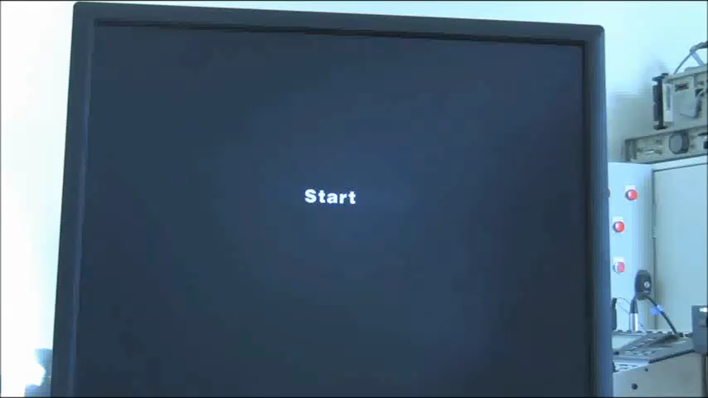
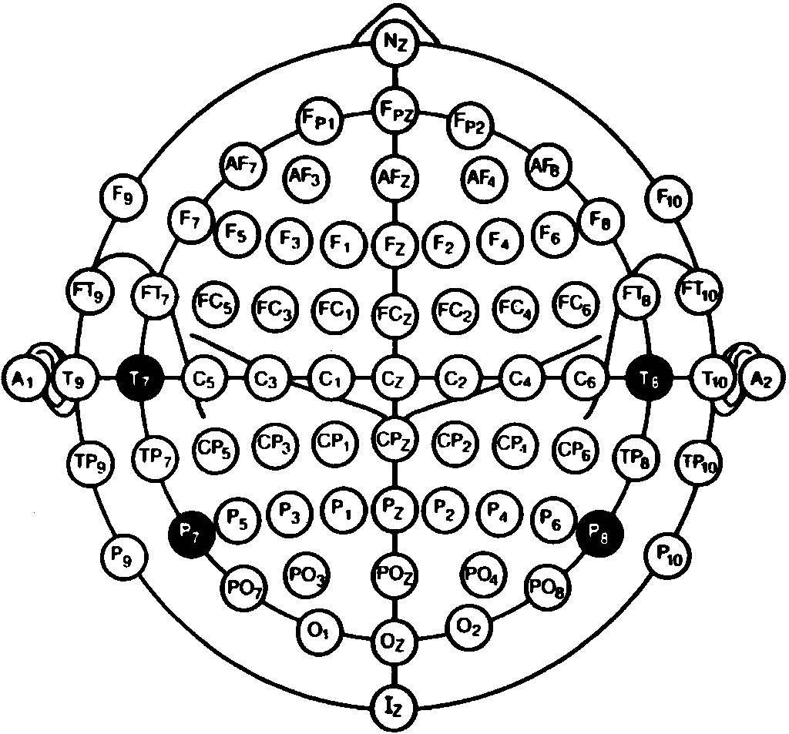
The Challenge
This particular Kaggle challenge has already been archived and was posed as part of the IEEE Neural Engineering Conference 2015 (NER2015) with the goal to flag errors in brain-computer interface responses through analysis of EEG data in the test subjects.
BCI

Slide 4
Course Relevance
EEG Data mapping brain activity
Due to data complexity machine learning algorithms are applied some of which are brain inspired such as certain neural networks
The experiment is based on a BCI setup and is geared towards improvements in BCI setups in order to make a more general application of BCI possible

Slide 5
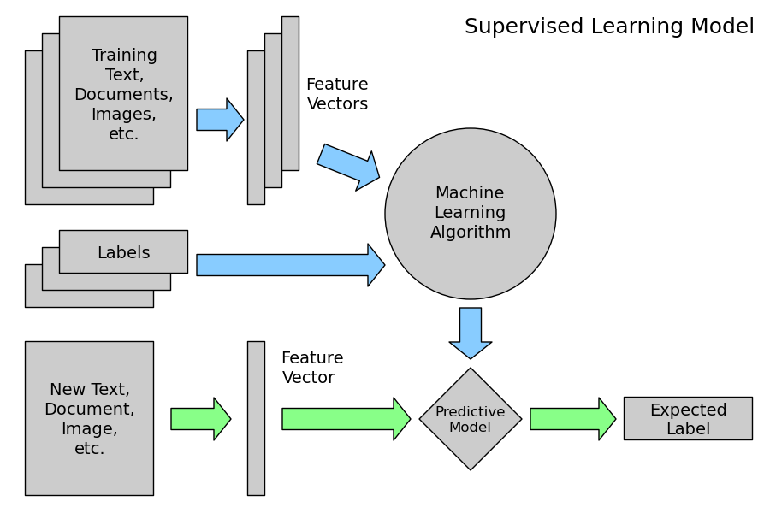
Classification Process
1. Preprocessing & Feature Extraction
2.
Build the Model/ Classifier
3.
Classify new data
Sklearn.org

Slide 6
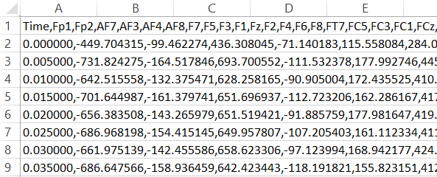
Classification process
Data Format:
EEG data:
- 16 test subjects, 5 sessions per person = 80 csv files
- 56 electrodes was measured at 200 Hz
- The timing of feedback events was labled
→ (= 8.7 GB)
1. Preprocessing & Feature Extraction
2.
Build the Model/ Classifier
3.
Classify new data
Sklearn.org

Slide 7
1. Preprocessing
Preprocessing:
Feedback related 1.3 second long chunks of EEG data cut out of complete data set
Application of Butterworth filter with a passband of 1-40 Hz (alpha activity 8-13 Hz, beta activity 13-31 Hz)
Amplitude Average over 1.3 seconds of the Butterworth filtered data

Slide 8
2. Machine Learning Algorithms
sklearn based implementations
Gradient Boosting Machine:
Number of estimators n = 500 or 1000
a single regression tree fit on the negative gradient of binomial deviance loss function
Best result 0.644, Channel 39, n = 500
Support Vector Machines:
Precision requirement C = 5
runtime issues with training (>15h)
best result 0.636, Channel 39, downsampled 5x, n = 500
Random Forrests:
Number of trees n = 500 or 1000
best result 0.697, Channel 39, n = 500
EEGlearn based implementations
Fully Connected Neural Network:
Linear sequential stack, epochs = 3000
Best result with cross referenced train data 0.84
Corresponding test result 0.5 (random)
Convolutional Neural Network:
Require images as input
Alpha, Beta, Theta bands are being averaged for this
Result 0.542, Epochs = 3000

Slide 9
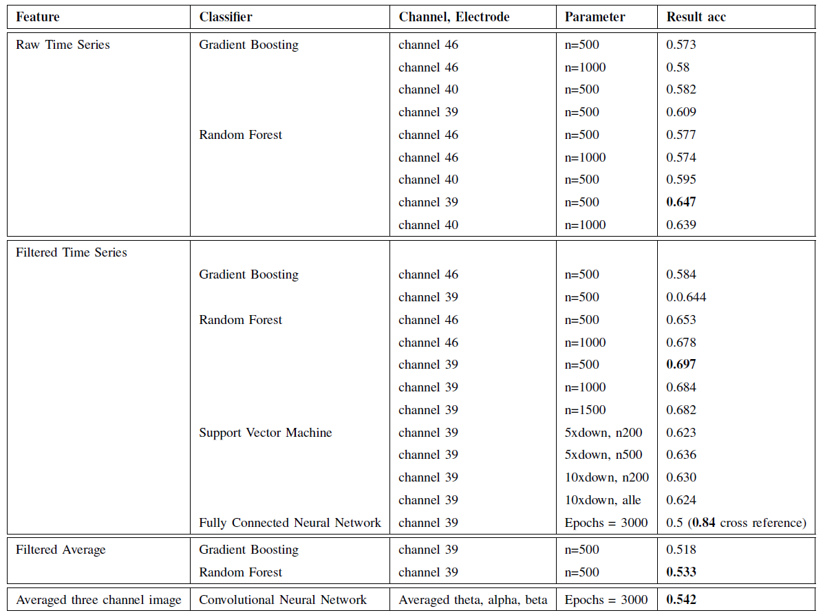
3. Classification Results Comparision
Random Forest Approach delivers best results in all categories
Prior knowledge about EEG data motivated Butterworth Filter application
Filtering showed positive impact
Averaging showed negative impact

Slide 10
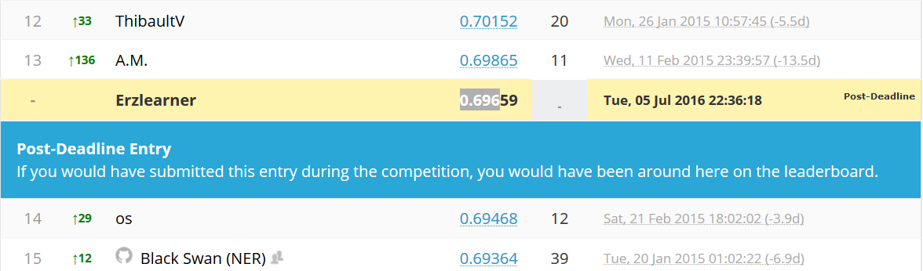
Ranking and Outlook
Challenge felt impactful
Motivation to work on future challenges
Future projects in this subject area

